Slide 1
ANALYSIS OF FINANCIAL FIGURES FOR BOBBLE IN STYLE.
Presented by :

Slide 2
INCOME STATEMENT
Income statement consists of revenue and expenses along with the net income.
It shows the position of the business with relevance to its financial information.
The revenue of Bobble in Style was found to be $22,800 .
And the Expenses as $14060
The Net Income before Tax was $8,740
After a tax of 26 % , the net income became, $6,468.00

Slide 3
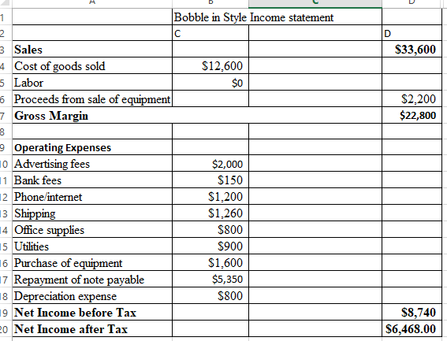
INCOME STATEMENT

Slide 4
BALANCE SHEET AS AT 01.01.2020
Balance Sheet reports the company’s assets, liabilities and equity .
It builds a basis for determining rates of return.
Evaluates the capital structure of the company.
The Bobble in style assets (fixed and current) as per 01.01.2020 were found to be $25,500.
The liabilities were found to be $6000 .
Equity on the other hand was $19000.
The assets and the equity plus liabilities balanced.

Slide 5
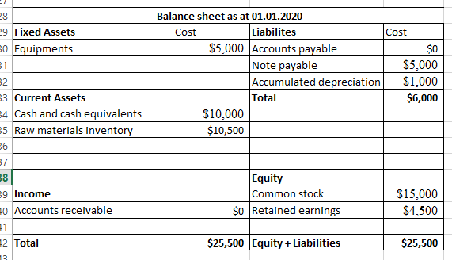
BALANCE SHEET

Slide 6
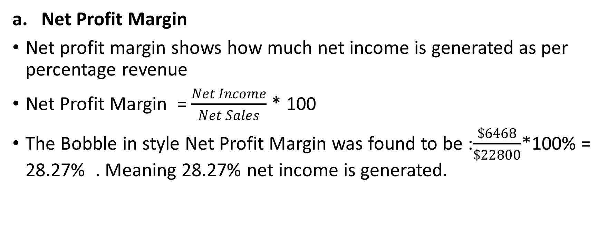
FINANCIAL RATIOS
Net Profit Margin
Net profit margin shows how much net income is generated as per percentage revenue
Net Profit Margin = $\frac{Net Income}{Net Sales}$ * 100
The Bobble in style Net Profit Margin was found to be :$\frac{\$6468}{\$22800}$*100% = 28.27% . Meaning 28.27% net income is generated.

Slide 7
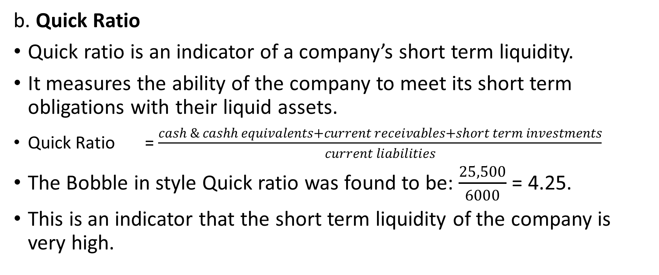
FINANCIAL RATIOS
b. Quick Ratio
Quick ratio is an indicator of a company’s short term liquidity.
It measures the ability of the company to meet its short term obligations with their liquid assets.
  Quick Ratio = $\frac{cash \& cashh equivalents+current receivables+short term investments}{current liabilities}$
The Bobble in style Quick ratio was found to be: $\frac{25,500}{6000}$ = 4.25.
This is an indicator that the short term liquidity of the company is very high.

Slide 8
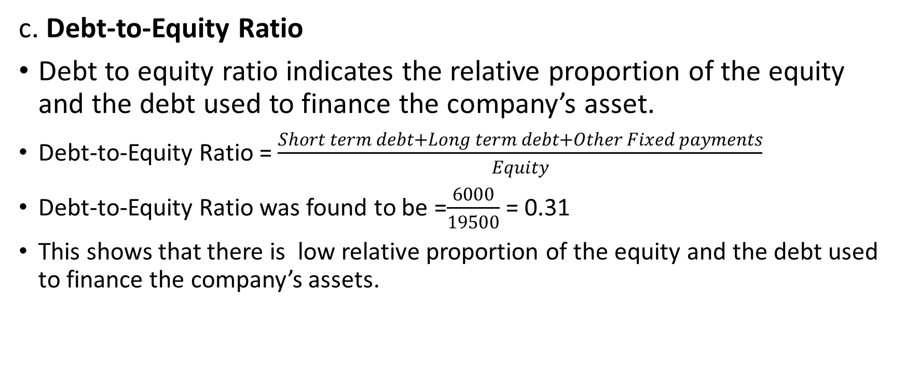
FINANCIAL RATIOS
c. Debt-to-Equity Ratio
Debt to equity ratio indicates the relative proportion of the equity and the debt used to finance the company’s asset.
  Debt-to-Equity Ratio = $\frac{Short term debt+Long term debt+Other Fixed payments}{Equity}$
  Debt-to-Equity Ratio was found to be =$\frac{6000}{19500}$ = 0.31
  This shows that there is low relative proportion of the equity and the debt used to finance the company’s assets.

Slide 9
COST CLASSIFICATIONS
Costs can be classified as either fixed or variable.
Fixed cost costs are the same regardless of the product’s output.
Variable costs on the other hand vary based on the product’s output.
Understanding the company’s fixed and variable costs allows you to identify the most profitable levels for your products.
It enable you analyse the break even margins and the profitable margins.

Slide 10
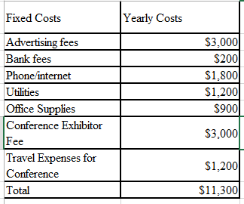
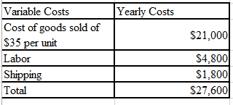
COST CLASSIFICATION
The following is a cost classification for preparing a budgeted income statement, assuming 600 units to be produced and sold.

Slide 11
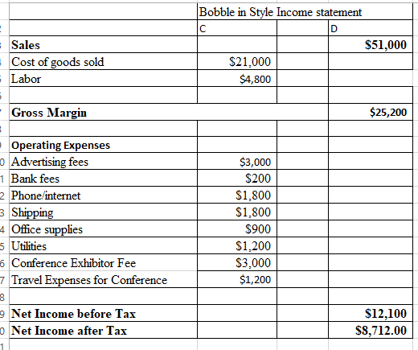
BOBBLE IN NEW INCOME STATEMENT.
New Income statement after assuming 600 units to be produced and sold.

Slide 12
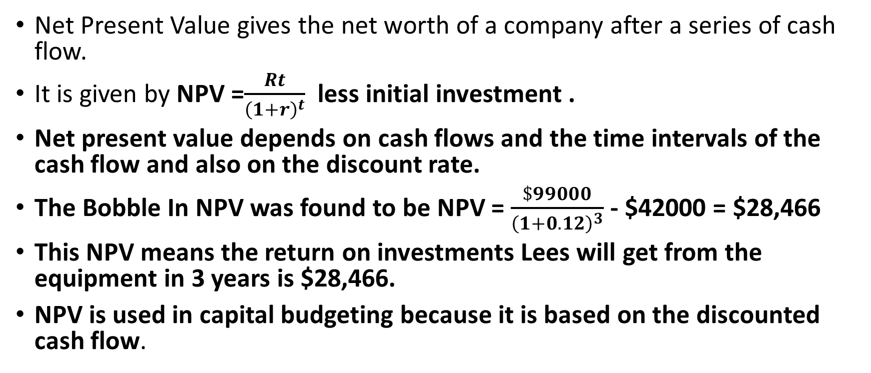
NET PRESENT VALUE
Net Present Value gives the net worth of a company after a series of cash flow.
It is given by NPV =$\frac{Rt}{{\left(1+r\right)}^{t}}$ less initial investment .
Net present value depends on cash flows and the time intervals of the cash flow and also on the discount rate.
The Bobble In NPV was found to be NPV = $\frac{\$99000}{{\left(1+0.12\right)}^{3}}$ - $42000 = $28,466
This NPV means the return on investments Lees will get from the equipment in 3 years is $28,466.
NPV is used in capital budgeting because it is based on the discounted cash flow.

Slide 13
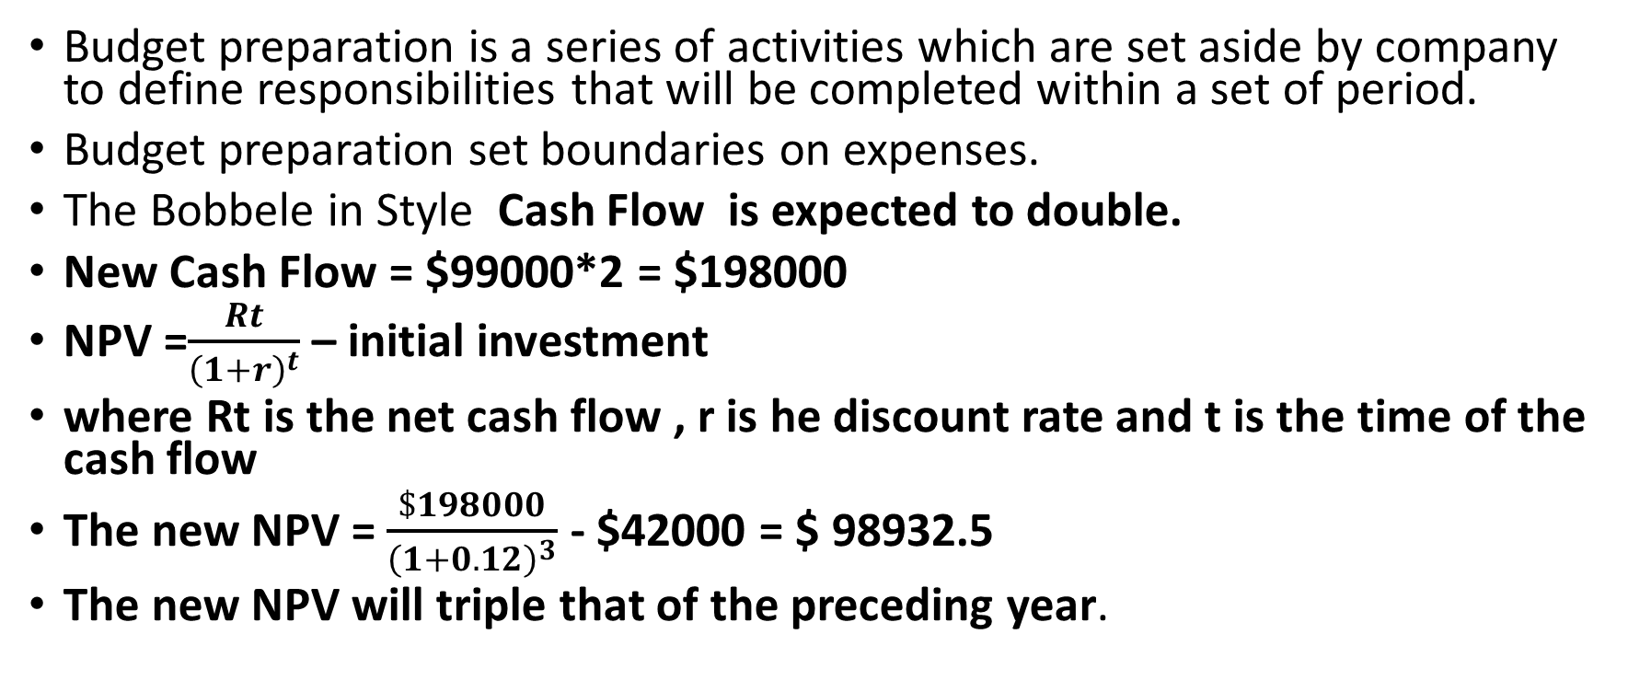
BUDGET PREPARATION
Budget preparation is a series of activities which are set aside by company to define responsibilities that will be completed within a set of period.
Budget preparation set boundaries on expenses.
The Bobbele in Style Cash Flow is expected to double.
New Cash Flow = $99000*2 = $198000
NPV =$\frac{Rt}{{\left(1+r\right)}^{t}}$ – initial investment
where Rt is the net cash flow , r is he discount rate and t is the time of the cash flow
The new NPV = $\frac{\$198000}{{\left(1+0.12\right)}^{3}}$ - $42000 = $ 98932.5
The new NPV will triple that of the preceding year.

Slide 14
INCREMENTAL ANALYSIS
Incremental analysis is a decision making technique in business that involves determining the cost difference between alternatives.
It helps identify the relevant revenues or the costs of each alternative and the expected impact of the alternative and how it affects future income.
Bobbles in were considering two options.
Option 1 revenue of $14400 and cost of $4200
Option 2 revenue of $16200 and cost of $1800
The incremental cost of choosing option 1
over 2 will result in a decrease.
Incremental Analysis Calculations
 | Option1 | Option 2 | Net Income (Increase, Decrease)
Revenues | $14400 | $16200 | $(1800)
Costs | $4200 | $1800 | $2400

Slide 15
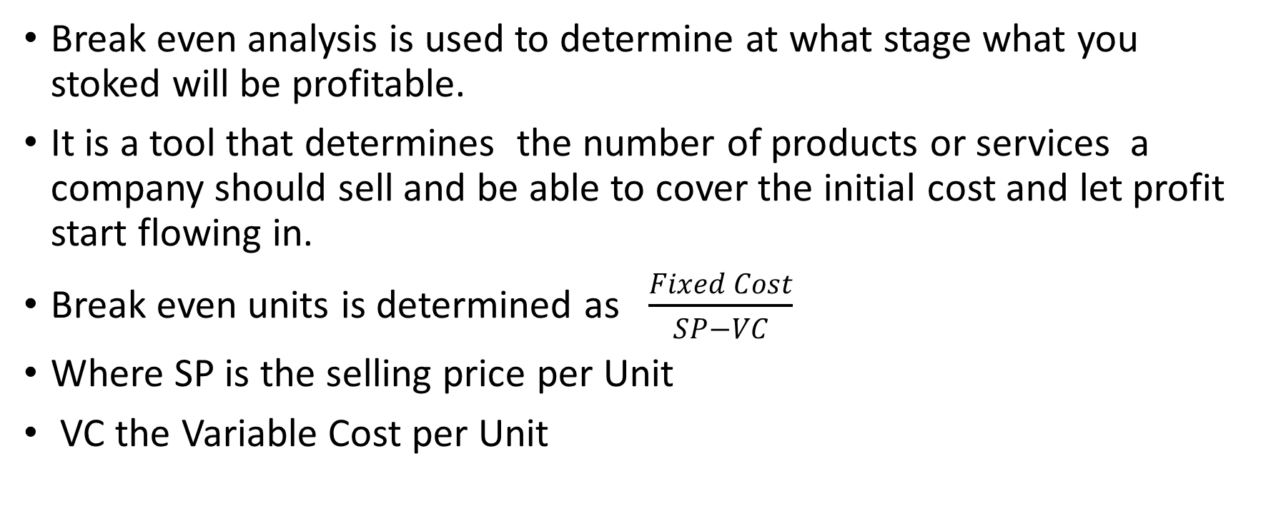
BREAK-EVEN ANALYSIS
Break even analysis is used to determine at what stage what you stoked will be profitable.
It is a tool that determines the number of products or services a company should sell and be able to cover the initial cost and let profit start flowing in.
Break even units is determined as $\frac{Fixed Cost}{SP−VC}$
Where SP is the selling price per Unit
VC the Variable Cost per Unit

Slide 16
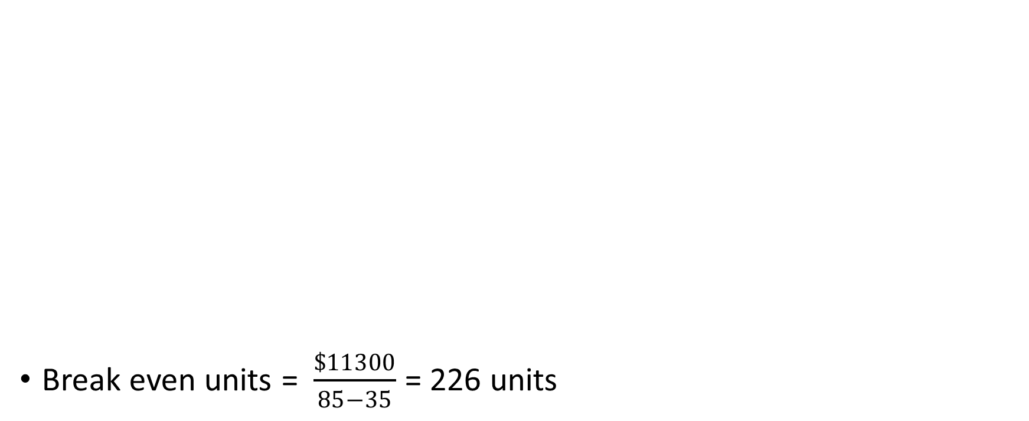
BREAK EVEN ANALYSIS
Break even units = $\frac{\$11300}{85−35}$ = 226 units
Fixed Costs | Yearly Costs
Advertising fees | $3000
Bank fees | $200
Phone/internet | $1800
Utilities | $1200
Office Supplies | $900
Conference Exhibitor Fee | $3000
Travel Expenses for Conference | $1200
Total | $11300

Slide 17
CONTRIBUTION MARGIN
Based on the Break-Even Analysis just performed, contribution margin can be performed.
Total Contribution Margin = Total sales – Total Variable Costs.
Contribution margin gives an entity that represents the total earnings available to pay for expenses and get a profit.

Slide 18
CONTRIBUTION MARGIN
Variable Costs | Yearly Costs
Cost of goods sold of $35 per unit | $21000
Labor | $4800
Shipping | $1800
Total | $27600
Total sales = 600 * $85 = $51000
Total Contribution Margin = $51000 - $27600 =$23400

Slide 19
CONCLUSION
Income statements are used to show the financial position of a company .
Balance Sheet reports the company’s assets, liabilities and equity .
Net profit margin shows how much net income is generated as per percentage revenue.
Quick ratio is an indicator of a company’s short term liquidity.
Debt to equity ratio indicates the relative proportion of the equity and the debt used to finance the company’s asset.
Understanding the company’s fixed and variable costs allows you to identify the most profitable levels for your products and do budget preparations.

